Slide 1

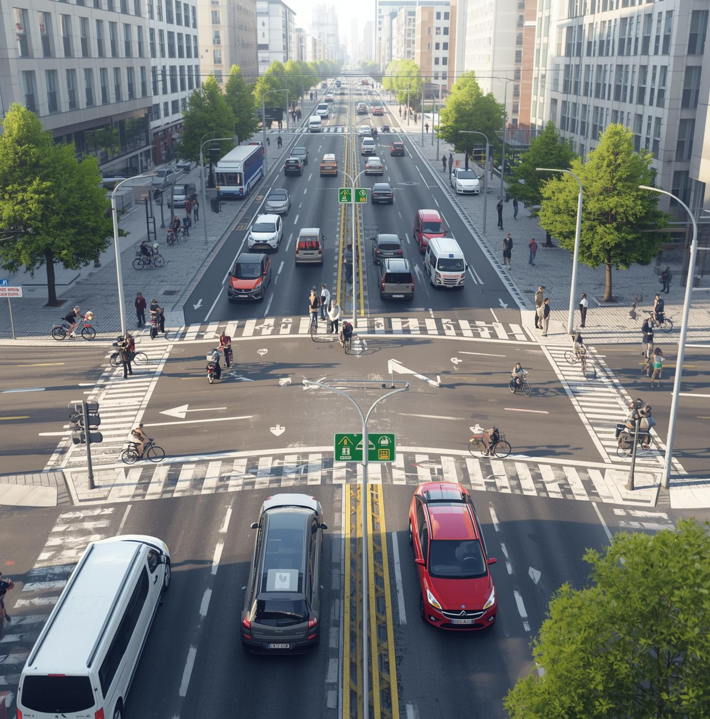
SCHOOL OF COMPUTER ENGINEERING
KALINGA INSTITUTE OF INDUSTRIAL TECHNOLOGY
Road Accident Analysis:Data Analysis & Insights
Guide: Dr. Ajit Kumar Pasayat

Slide 2


Team Members:
Arpit Kumar Mantra(22051929)
Anuranjan Tripathi(22051926)
Bhagyashree Singh(22051932)
Hardik Mazumdar(22051939)
Suryasnata Paital(22051990)
Srijani karmakar(22053643)

Slide 3

Introduction:
India has one of the highest accident rates globally.
Objective: Understand accident patterns → reduce fatalities.
Finally, we summarized total accidents, injured people, and deaths for each state.
What reasons cause deaths and injuries?
And derived insights that can help improve road safety policies.

Slide 4
ABOUT THE PROJECT
Our datasets came from government sources and contained values per 1 lakh population.
We cleaned the data, removed null values, handled long column names
We used Python with Pandas, NumPy and Matplotlib for data cleaning, processing and visualization.
In the end, we created clear graphs and insights that can help improve road safety decisions.

Slide 5
Why did we build this project?
Analyze
Identify high-risk
Analyze real-life accident causes using data science.Understand how infrastructure (like lanes) affects accident rates.
Identify which vehicles are most risky.Identify which road types cause more accidents
Prevent Accident
End-to-End Analysis
Identify which reasons cause maximum deaths.Suggest how to reduce accidents. Built an interactive tool for policymakers. Helped in deriving actionable insights
This project provided complete end-to-end data analysis. Cleaning data, analyzing the dataset, creating graphs, comparing factors, deriving conclusions.

Slide 6

Dataset Description
Lane accident dataset
Vehicle type dataset
Reason-of-accident datase
GeoJSON for Indian statest
Technologies Used
Python
Pandas, NumPy
Matplotlib/Seaborn
VS Code / Jupyter Notebook
GitHub / Git
Bar Graphs

Slide 7
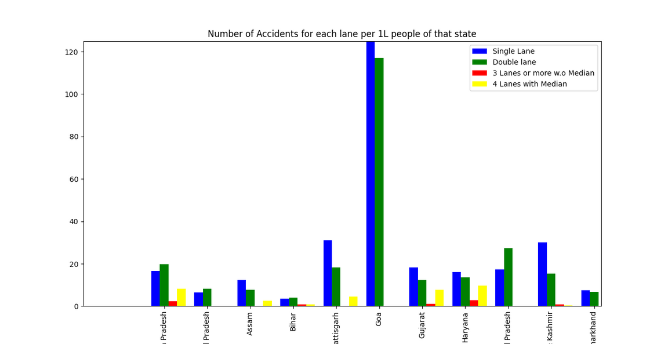
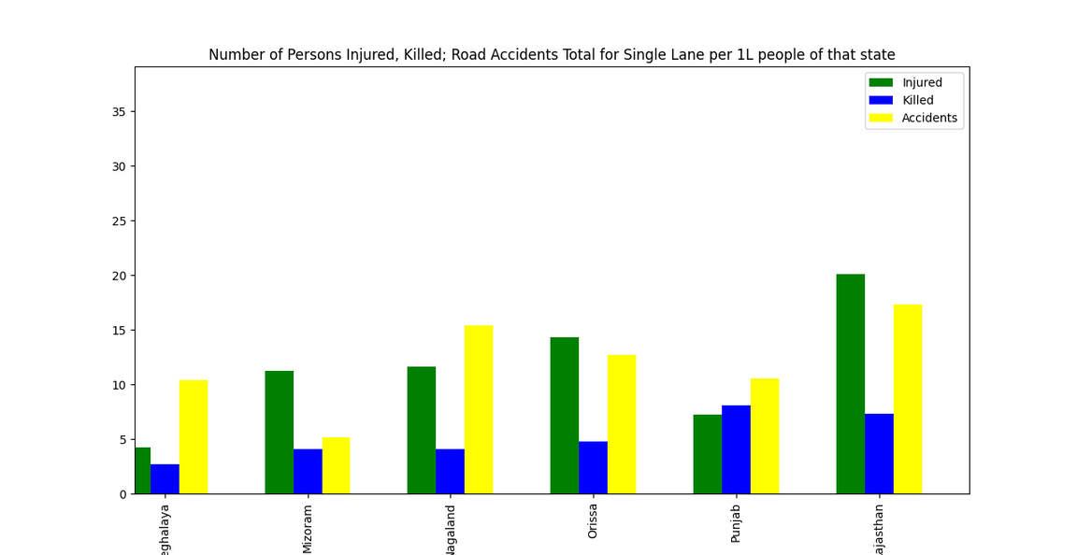
Data Analysis Outcome:
Frequency by Lane
Person Injured or Killed

Slide 8
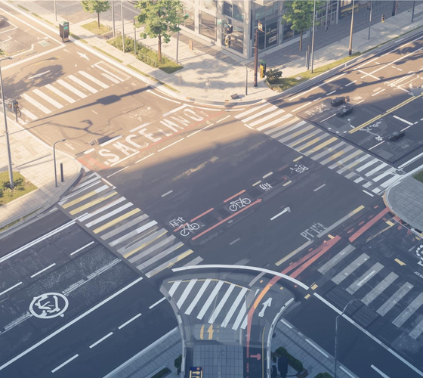
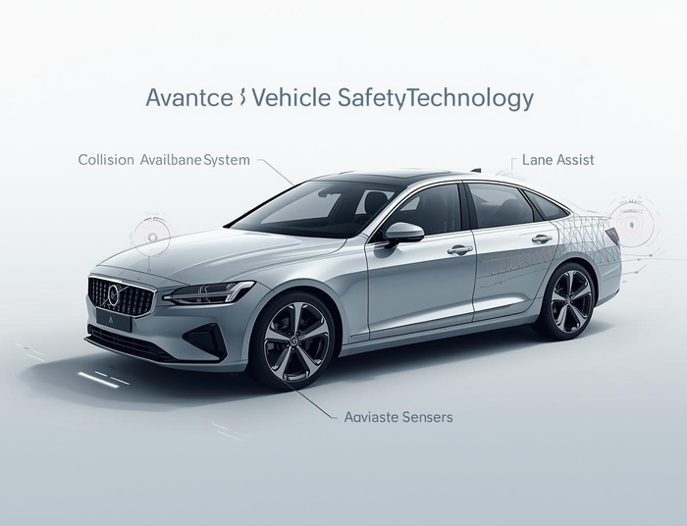

Prevention Measures for Safer Roads:
01
02
03
Design
Vehicle Safety
Awareness
Thoughtful layouts reduce accidents and improve safety Widen narrow two-lane roads. Add proper lane markings & reflective indicators
Ensure proper maintenance of brakes, lights, and tires. Promote ABS-enabled two-wheelers and airbag-equipped cars
Comprehensive programs enhance driver skills and awareness. Conduct road safety programs in schools & colleges

Slide 9
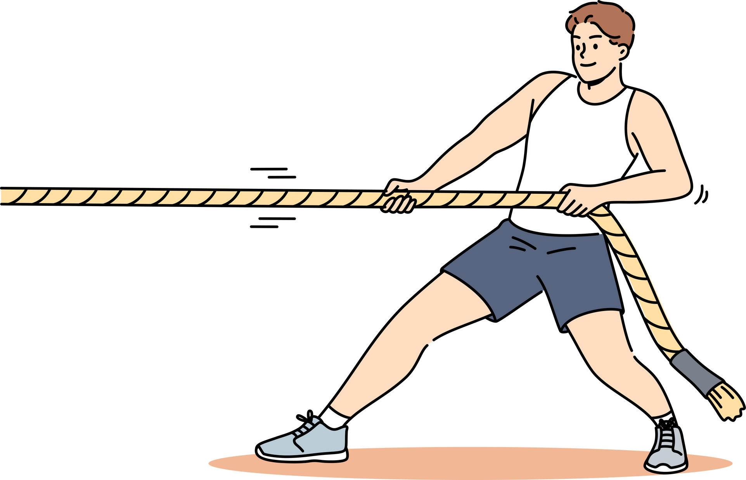
Challenges We Faced:
Data Cleaning - Datasets had missing values, extremely long column names, inconsistent spellings, wrong formatting.
Visualizing very wide graphs - We fixed it by Rotating labels, Changing spacing, Using many separate charts
Understanding per 1 lakh population- We initially got confused but learned that: for fair comparison, accidents are given per 1 lakh population.
Missing columns & inconsistent naming,and heavy dataset causing slow rendering

Slide 10
CONCLUSION:
This project provided complete end-to-end data analysis
Identified critical road safety issues
Built an interactive tool for policymakers
Helped in deriving actionable insights
KEY INSIGHTS :
Single-lane roads have the highest accident rates
Driver fault is the biggest reason for accidents
Two-wheelers are involved in the highest number of accidents
States with 4-lane divided roads show much lower fatalities

Slide 11
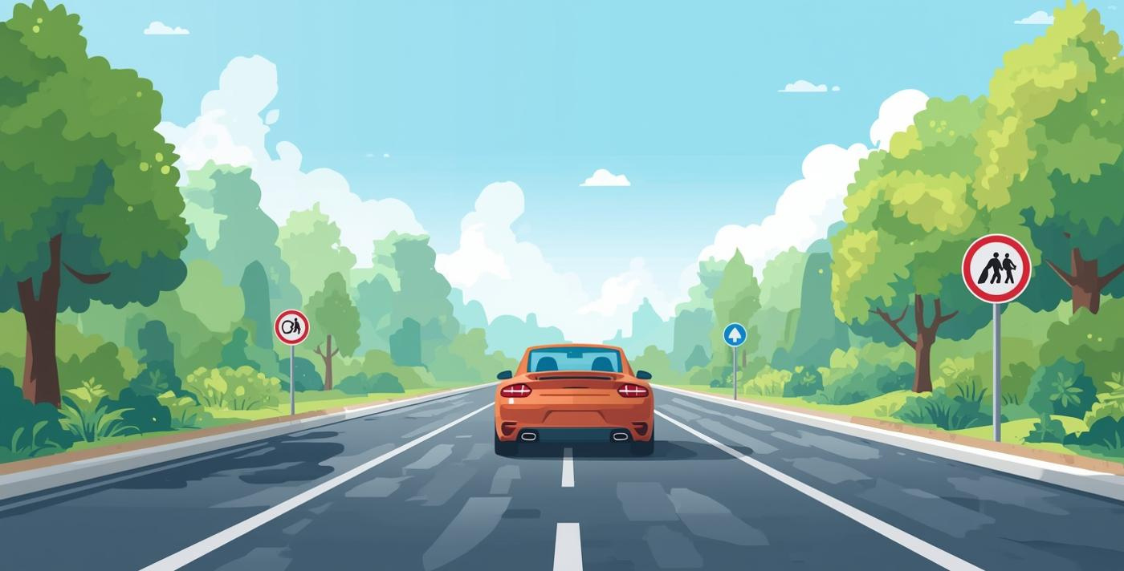
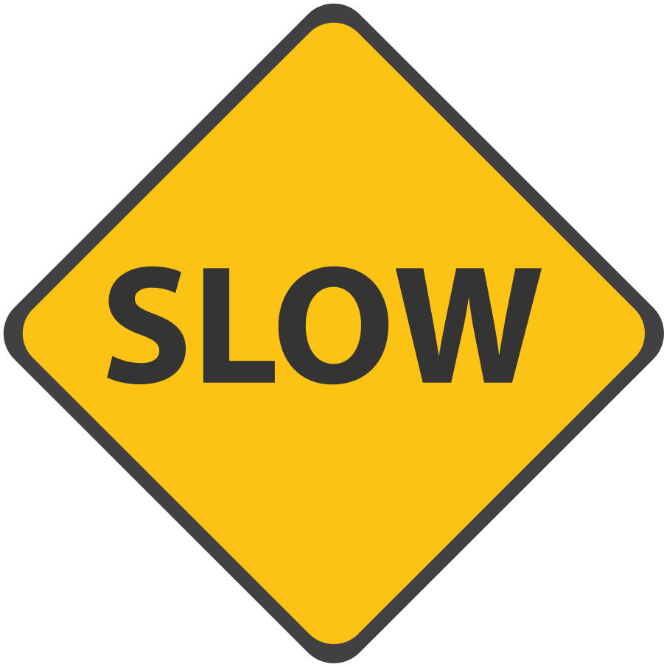
Stay Safe on the Road!

